Slide 1
MusicXStream Pro
Time-Series Business Analytics Dashboard
Power BI Dashboard Analysis for a Music Streaming Platform
Sprint 1 Project | 2023 – 2025 streaming data

Slide 2
Presentation Flow
Introduction
Brief about the platform & dashboard purpose
01
02
Objective
What problems the dashboard solves
MusicXStream
Pro
Dataset Summary
Source, period, key fields
03
04
KPI Overview
Streams, listeners, likes, shares, revenue
Dashboard Insights
Genre, platform, artist, trend, country
05
06
Recommendations & Conclusion
Business actions + wrap up

Slide 3
Objective of the Project
01
02
03
04
05
Track total streams, listeners, likes & shares
Compare platform performance & revenue
Identify top genres, artists & countries
Monitor monthly engagement trends
Visualize KPIs for business decisions

Slide 4
Dataset Overview
Fact table: Fact_MusicStreaming (song-level streaming for 5100 records)
Time period: 2023 to 2025 (Year and Month slicer)
5 platforms, 8 genres, 12 artists, 8 countries shown on the report
Key fields include:
Stream_ID, StreamDate, Song, Artist, Genre
Platform, Country, Streams, Listeners, Likes, Shares
Revenue, Engagement Rate, PlaylistAdds
Streaming data model

Slide 5
Key KPIs Analyzed
Total Streams
Total Listeners
Total Likes
Total Shares
Revenue
Engagement Rate

Slide 6
KPI Performance Snapshot
2555.26M
1477.12M
129M
25.42M
766.58M
0.12
Total Streams
Total Listeners
Total Likes
Total Shares
Revenue
Engagement Rate
1
Streams (2555.26M) exceed listeners (1477.12M) – about 1.7 streams per listener, showing repeat listening
2
Revenue of 766.58M shows strong monetisation of the stream base
3
Shares (25.42M) are about one-fifth of likes (129M) – sharing is the weaker engagement action
4
Engagement rate of 0.12 gives a baseline to improve month by month

Slide 7
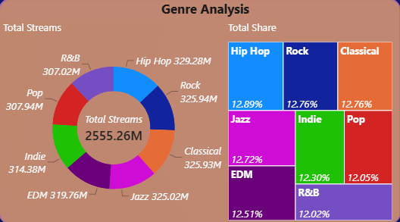
Streams by Genre
Observations
✔ Hip Hop leads: 329.28M streams (12.89% share)
✔ Rock 325.94M and Classical 325.93M follow
✔ Pop (307.94M) and R&B (307.02M) are lowest
Insights
✔ All 8 genres sit within about 12–13% share
✔ Catalogue is balanced – no single-genre risk
Business Impact
✔ Keep a broad catalogue; push Pop and R&B playlists to close the gap, and feature Hip Hop in campaigns
Genre

Slide 8
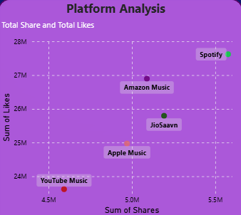
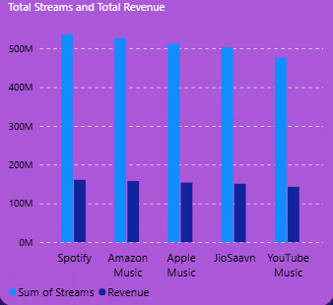
Platform Performance
Observations
✔ Spotify is highest on likes and shares; YouTube Music is lowest
✔ Streams range from about 480M to 540M per platform
✔ Revenue is similar across platforms (about 145M–165M)
Insights
✔ Spotify is the Best Performing Platform
Business Impact
✔ Lift revenue per stream on lower-yield platforms through premium conversion and platform-specific offers
Platform Page

Slide 9
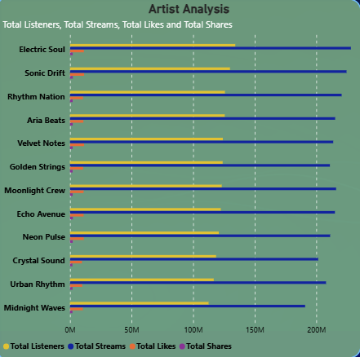
Artist Performance
Observations
✔ Electric Soul is the Top Artist on every measure
✔ Streams run from about 190M to 230M across the 12 artists
✔ Listeners run from about 110M to 135M
Insights
✔ Artist performance is tightly grouped; likes and shares are far smaller than streams
Business Impact
✔ Back Electric Soul with featured placements
✔ Promote mid-ranked artists to widen the star base
Artist Page

Slide 10
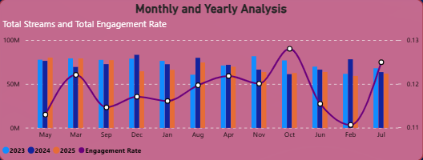
Streams & Engagement Over Time
Observations
✔ Engagement rate ranges about 0.11 to 0.13
✔ Peak around October; lowest around February
✔ Monthly streams stay steady across 2023–2025
Insights
✔ Streams are stable, so engagement swings are the real signal
Business Impact
✔ Time campaigns before February dips; sort the axis by Month Number so trends read left to right
Trend Page

Slide 11
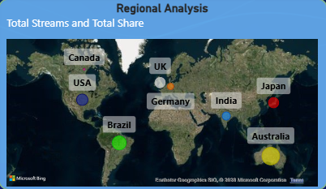
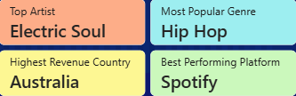
Country Performance & Top Performers
Observations
✔ Map plots Canada, USA, Brazil, UK, Germany, India, Japan, Australia
✔ Australia has the highest revenue
Business Impact
Top picks
✔ Prioritise Australia for premium offers and test similar markets
✔ Electric Soul | Hip Hop | Australia | Spotify
Country Page

Slide 12
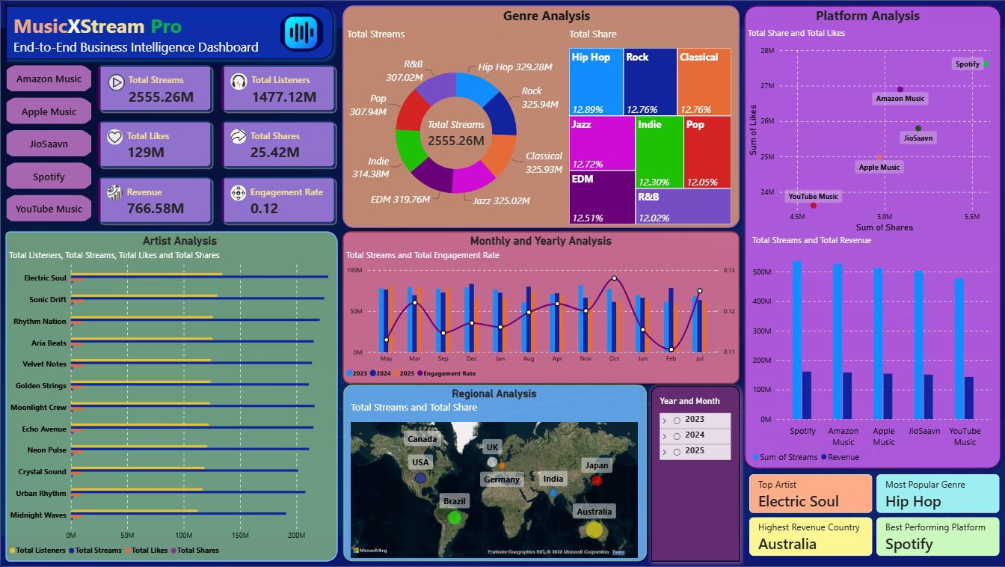
Final Dashboard
Overview page: KPI cards, platform filters, genre, platform, artist, trend and country views with a Year and Month slicer
Home Page

Slide 13
Insights & Business Recommendations
Insights
Business Recommendations
✔ 2555.26M streams from 1477.12M listeners generated 766.58M revenue
✔ Hip Hop leads genres, but all 8 are within 12–13%
✔ Spotify is the top platform; YouTube Music trails on likes and shares
✔ Electric Soul is the top artist
✔ Engagement (0.11–0.13) peaks in October and dips in February
✔ Australia is the highest-revenue country
✔ Grow repeat listening: playlists and personalised recommendations
✔ Boost shares with easy in-app sharing and social campaigns
✔ Run February re-engagement campaigns
✔ Lift revenue per stream on lower-yield platforms
✔ Invest in Australia and look for similar markets

Slide 14
THANK
YOU

